Slide 1
RELATIONAL DATABASE MANAGEMENT SYSTEM
Chapter – 1
Introduction to Database System
By Aman Singh

Slide 2
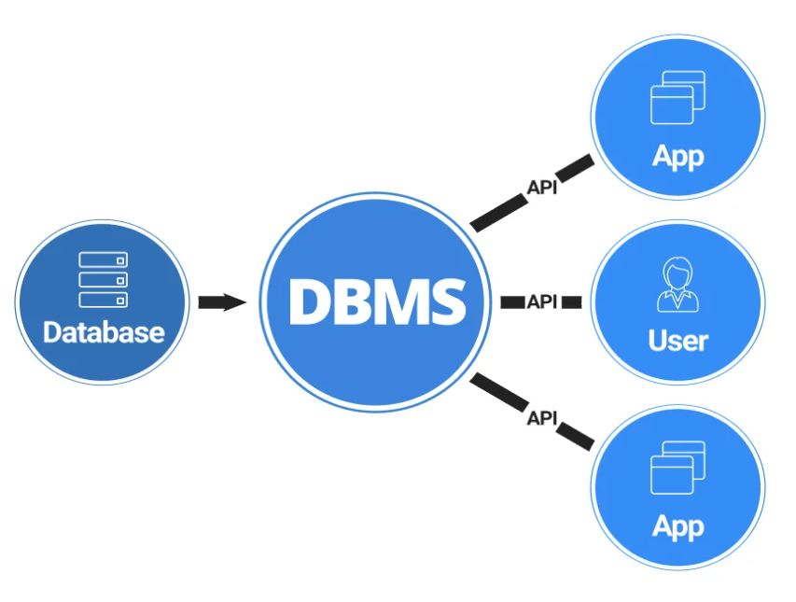
What is Database Management System?
Database Management Systems (DBMS) are software systems used to store, retrieve, and run queries on data.
A DBMS serves as an interface between an end-user and a database, allowing users to create, read, update, and delete data in the database.
A DBMS stores data in such a way that it becomes easier to retrieve, manipulate, and produce information.

Slide 3
Why Database Management System?
Database management systems help users share data quickly, effectively, and securely across an organization.
What once was done completely manually now can be fully automated and more accurate.
By using a proper database management system and data quality tools, you can be sure that an accurate view of data is shared throughout your organization.
It provide a better framework for the enforcement of privacy and security policies.
Deploying a DBMS typically results in increased productivity because a good DBMS empowers people to spend more time on high-value activities and strategic initiatives, and less time cleaning data and manually scrubbing lists.

Slide 4
What is Data?
Data is a Collection of raw facts.
Data can be in the form of any Character, Text, Numbers, Picture's, Audio’s and Video’s.
Data is like dustbin materials, until it is used.
Data can be stored at the low cost.
In simple words we can say Data is Raw Materials.

Slide 5
What is Information?
Information is a group of data that collectively carries a logical meaning.
Information is also collection of raw facts but it has specific meaning.
Information is dependent on data.
In simple words we can say “Information is Processed Data”.
PROCESS
DATA
INFORMATION

Slide 6
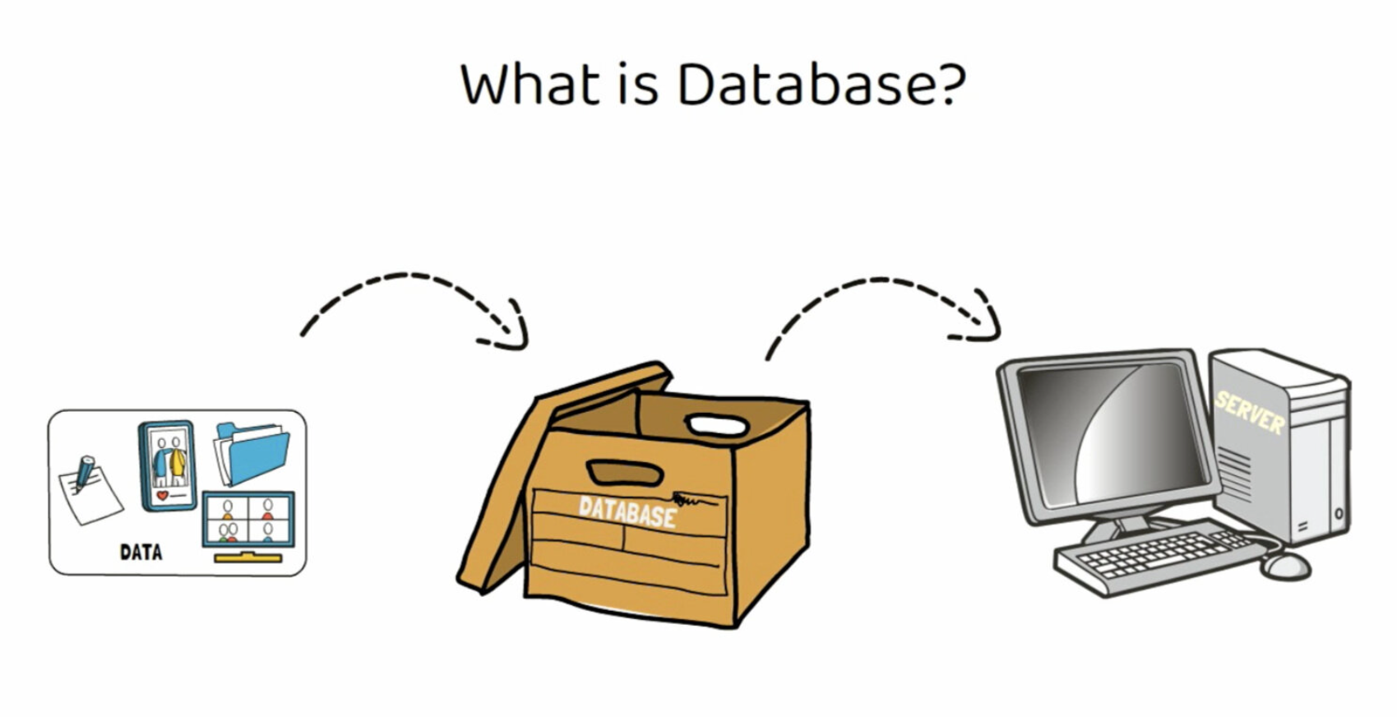
What is Database?
A Database is a collection of structured information, or data, stored and accessed electronically.
Database is organized collection of related information.
Examples – Phone Book, Address Book, Mobile Contacts

Slide 7
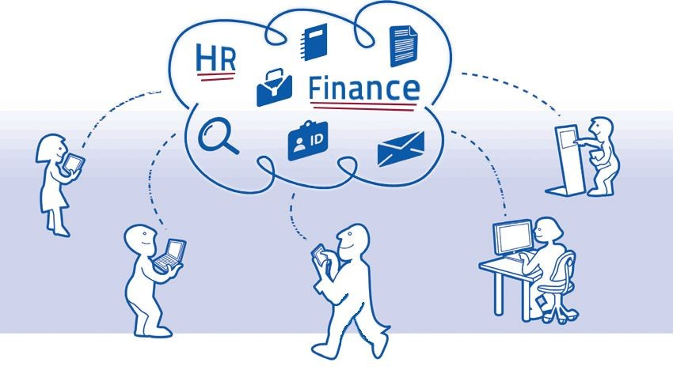
File Based Data Management
The computer systems that are used to organize and maintain data files are known as file based data systems. These file systems are used to handle a single or multiple files and are not very efficient in use.

Slide 8
Advantage of File Based System
The file Based system is not complicated and is simpler to use.
Because the file based system is simple and cheap, it is normally suitable for home users and owners of small businesses.
Since the file based system is used by smaller organisations or individual users, it stores comparatively lesser amount of data. Hence, the data can be accessed faster and more easily.

Slide 9
Disadvantage of File Based System
The File based system is limited to a smaller size and cannot store large amounts of data.
This system is relatively uncomplicated but this means it cannot support complicated queries, data recovery etc.
There may be redundancy of data in the file based system as it does not have a complex mechanism to get rid of it.
The data is not very secure in a file based system and may be corrupted or destroyed.
The files in the file based system may be stored across multiple locations. Consequently, it is difficult to share the data easily with multiple users.

Slide 10
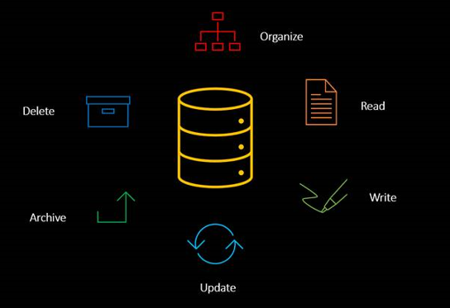
Database
A database is an organized collection of data, so that it can be easily accessed and managed.
You can organize data into tables, rows, columns, and index it to make it easier to find relevant information.
Let's consider the Facebook. It needs to store, manipulate and present data related to members, groups and pages, their friends, member activities, messages, advertisements and lot more.
An online telephone directory definitely use database to store data related to people, phone numbers, other contact details, etc.

Slide 11
Organization of Database
Understanding Records and Fields
Understanding how databases are organized can help you retrieve information more efficiency, Information about each item in a database is called record.
Elements of an individual record are called fields. Fields can be used as points of access when searching a data in database.
Each column in the table represents the fields and each row represents the individual record.

Slide 12
Organization of Database
The table below represents what an database of students in a class might look like –
First_name | Last_name | Department | Hometown | Birthdate
Prince | Patel | BCA | Vadodara | 08-01-2003
Jaynil | Patel | BScIT | Surat | 02-25-2002
Rahul | Jha | BCA | Indore | 11-30-2001
Kalpesh | Patil | MCA | Mumbai | 02-22-2002
Varun | Reddy | IMCA | Surat | 02-09-2003

Slide 13
Characteristics of Data in Database
The data in the database possess several characteristics data in the database are consistent [standard behaviour], integral [necessary to make something complete], non redundant [not repetition], secured centrally managed and shared among multiple applications.
Advantages are given below –
Single repository of data is maintained
All users access the data from the same resources Quick retrieval of data.
Reduce application development time
Flexibility in change of database structure.
Enforce Standardization.
Up-to-date information availability
Authorized access security of data.
Enforce integrity constraints and business rules
Provide backup and recovery procedure.

Slide 14
Benefits of RDMS
Reducing Data Redundancy
The file based data management systems contained multiple files that were stored in many different computer system locations in a system or even across multiple systems. Because of this, there were sometimes multiple copies of the same file which lead to lots of data redundancy.
This is prevented in a database as there is a single database and any change in it reflected immediately. Because of this, there is no chance of encountering duplicate data in it.

Slide 15
Benefits of RDMS
Sharing of Data
Data sharing implies that the data are stored in one or more servers in the network or system and that there is some software locking mechanism that prevents the same set of data from being changed by two user at the same time. Data sharing is a primary feature of a DBMS.
Data Security
Data Security is vital concept in a database. Only authorized users should be allowed to the access the database and their identity should be authenticated using a username and password. Unauthorized users should not allowed to access the database under any circumstances as it violates the integrity constraints.

Slide 16
Benefits of RDMS
Privacy
The privacy rule in a database means only the authorized users can access a data in database according to its privacy constraints. There are levels of database access and a user can only view the data he is allowed to view. For example - In social networking sites, access constraints are different for different accounts a user may want to access account.
Backup and Recovery
DBMS automatically takes care of backup and recovery. The users don't need to backup data periodically because this is taken care of by the database management system. Moreover, it also restores the database after a crash or system failure to its previous condition of it.

Slide 17
Benefits of RDMS
Data Consistency
Consistency in database systems refers to the requirement that any given database required transaction must change affected data only in allowed ways. Any data written to the database must be valid according to all defined condition and rules, including constraints, cascades, triggers, and any combination thereof.
For example, a column in a database may only have the values for a coin flip as "heads" or "tails." If a user were to attempt to put in "sideways," consistency rules for the database would not allowed it

Slide 18
Functions of DBMS
Data Dictionary Management,
Data Storage Management,
Data Transformation and Presentation,
Security Management,
Multi user Access Control,
Backup and Recovery Management,
Data Integrity Management,
Database Access Languages and Application Programming Interfaces and
Database Communication interfaces.

Slide 19
Functions of DBMS
Data Dictionary Management
Data Dictionary Management is the one of the most important function of DBMS.
That is, data that provides information about the database’s tables, views, constraints, stored procedures, etc. stored within the database. If we take a table as an example, the dictionary will store information such as: its name and other attributes.
Data Storage Management
Data Storage management refers to the management of the data information storage equipment's that are used to store the user / computer generated data. So it is a tool or set of processes used by an administrator to keep your data and storage equipment's safe and secure. Typical examples of such tools include: Data Dynamics Inc.

Slide 20
Functions of DBMS
3. Data transformation and presentation
The database management system transforms entered data in to required data structures. The database management system relieves you of the chore of making a distinction between the logical data format and the physical data format. That is, the database management system formats the physically retrieved data to make it conform to the user’s logical expectations.
For example, imagine an enterprise database used by a MNC company. An end user in England would expect to enter data such as July 12, 2009, as “12/07/2009.” In contrast, the same date would be entered in the United States as “13/11/2009.” Regardless of the data presentation format, the database management system must manage the date in the proper format for each country.

Slide 21
Functions of DBMS
4. Security Management
Security Management is another important function of DBMS. The database management creates a security system that enforces user security and data privacy. Security rules determine which authorized users can access the database, which data items each user can access, and which data operations (read, add, delete, or modify) the user can perform.
This is important in multiuser database systems.
5. Multi User Access Control
Multiuser access control is another important database management system Function. To provide data integrity and data consistency, the database management system uses sophisticated algorithms to ensure that multiple users can access the database concurrently without compromising the integrity of the database

Slide 22
Functions of DBMS
6. Backup and Recovery Management
The database management system provides backup and data recovery to ensure data safety and integrity.
Current database management systems provide special utilities that allow the DBA to perform routine and special backup and restore procedures. Recovery management deals with the recovery of the database after a data failure, such as a bad sector in the disk or a power failure. Such capability is critical to preserving the database accuracy and integrity.

Slide 23
Functions of DBMS
7. Data Integrity Management
Data integrity management is another important database management system function.
The database management system promotes and enforces integrity rules, thus minimizing data redundancy of data and maximizing data consistency.
The data relationships stored in the data dictionary are used to enforce data integrity of data. Ensuring data integrity is important database management system functionality in transaction-oriented database systems.
8. Database Access Languages and Application Programming Interfaces(API)
The database management system provides data access through a query language. A SQL query language is a non procedural language—one that lets the user specify what must be done without having to specify how it is to be done. SQL is the defector query language and data access standard supported by the majority of database management system vendors

Slide 24
Functions of DBMS
9.Database Communication Interfaces
Current-generation DBMS's accept end-user requests via multiple, different network environments. For example, the DBMS might provide access to the database via the Internet through the use of Web browsers such as Mozilla Firefox or Microsoft Internet Explorer.
In this environment, communications can be accomplished in several ways:
End users can generate answers to queries by filling in screen forms through their preferred Web browser.
The DBMS can automatically publish predefined reports on a Website.
The DBMS can connect to third-party systems to distribute information via e-mail or other productivity applications.

Slide 25
Components of DBMS
There are five major components in the database system environment and their interrelationship is.
Hardware
Software
Data
Users
Procedures

Slide 26
Components of DBMS
Hardware:
The hardware is the actual computer system used for keeping and accessing the data in database.
Conventional database management system hardware consists of secondary storage devices, usually hard disks, on which the database physically resides, together with the associated Input-Output devices, device controllers and· so forth.
Databases run on some range of machines, from Microcomputers to large mainframes computer.
Other hardware issues for a database management system includes database machines, which is hardware designed specifically to support a database system.

Slide 27
Components of DBMS
2. Software:
The software is the actual database management system. Within the physical databases itself (i.e. the data actually stored) and the users of the system is a layer of software, usually called the DBMS.
All requests from users for access to the database are handled by the database management system. One general function provided by the database management system is thus the shielding of database users from complex hardware-level detail.
The database management system allows the users to communicate with the database. In a sense, it is the mediator within the database and the users.

Slide 28
Components of DBMS
3. Data:
It is the most important component of database management system environment from the end users point of view.
As shown in observes that data acts as a bridge within the machine components and the user components. The database contained the operational data and the meta-data, the 'data about data'.
The database should be contain all the data needed by the a organization. One of the major features of data in databases is that the actual data are separated from the programs that use the data.
A database should always be designed, built and populated for a particular audience, user and for a specific purpose.

Slide 29
Components of DBMS
4. Users:
There are a number of users who can access or retrieve data on the demand using the applications and interfaces provided by the database management system.
Each type of user needs different type of software capabilities. The users of a database system can be classified in the following groups, depending on their degrees of expertise or the mode of their interactions with the database management system. The users can be:
Naive Users
Online Users
Application Programmers
Sophisticated Users
Data Base Administrator

Slide 30
Components of DBMS
Naive Users : Naive Users are those users who must need not be aware of the presence of the database system or any other system supporting their usage. Naive users are end users of the database who work with a menu driven application program, where the type and range of response is always indicated to the audience or user .
A full user of an Automatic Teller Machine falls in this category. The one by one user is instructed through each step of a transaction. Then responds by pressing a coded key. The operations that can be performed by valve users are very limited and affect only a precise portion of the data in database. For example, in the case of the user of the ATM, user's action affects only one or more of his/her own accounts.

Slide 31
Components of DBMS
Online Users: Online users are those who may communicated with the database directly via an online terminal. These users are aware of the presence of the data in database system and may have acquired a certain amount of expertise with in the limited interaction permitted with a data in database.
Sophisticated Users: Such users in database interact with the system without, writing programs.
Instead, they form their requests in database. Each such query is submitted to a very processor whose function is to breakdown data manipulation language statement into instructions that the storage manager understands.

Slide 32
Components of DBMS
Specialized Users: Such users are those, who write specialized in data in database application that do not fit into the fractional data-processing framework. For example: CAD systems, knowledge base and expert system, systems that store data with complex data types (for example, graphics data and audio data).
Application Programmers: Professional programmers are those who are responsible for developing application programs and user interface. The application programs could be written using the commands available to manipulate a database.

Slide 33
Components of DBMS
Database Administrator: The database administrator is the person or group in charge for implementing the database system ,within an organization. Database administrator has all the system privileges allowed by the DBMS and can assign and revoke levels of access to and from other users. database administrator is also responsible for the evaluation, selection and implementation of database management system package.

Slide 34
Data Dictionary
A data dictionary is a set of files that contains a database metadata. The data dictionary contains records about other objects in the database, such as data ownership, data relationships to other objects, and other data in database.
The data dictionary is a component of any relational database. because of its mandatory use, it is invisible to most database users. Typically, only DBA interact with the data dictionary.
The most of metadata in the data dictionary includes the following:
Names of all tables in the database and their owners
Names of all indexes and the columns to which the tables in those indexes related.
Constraints defined on tables, including primary keys, foreign-key relationships to other tables, and not-null constraints

Slide 35
Internal Level
The lowest level of data abstraction.
It shows How the data are actually stored on storage devices.
It is also known as physical level.
It is a internal view of physical storage of data.
It deals with complex low level data structures, file structures and access all the methods in detail.
It also deals with Data Compression and Encryption techniques, if used.

Slide 36
Conceptual Level
It is a next higher level than internal level of data abstraction.
It describes What or how data are stored in the database and What relationships exist among those data.
It is also known as Logical level.
It hides low level complexities of physical storage of database.
Database administrator and designers work at this level to determine What or how data to keep in database. Application developers also work in this level .

Slide 37
External Level
It is a highest level of data abstraction.
It describes only one part of the entire database that a end user concern.
It is also known as an view level.
End users need to access only part of the database rather than entire database.
Different user need different views of database. And so, there can be many view level abstractions of the same database.

Slide 38
The best thing to do is always keep randomly generated passwords everywhere and use a password tool to manage it, and then you don't have to remember those passwords at all, just the master password that unlocks the database..” - Kevin Mitnick

Slide 39
Thank You ☺

